Slide 1

Global Alcohol Consumption Analysis – WHO Global Health Observatory
A Data-Driven Approach to Public Health Insights
Presented by Gatsinzi Ernest (ID: 26622)
Date: August 04, 2025

Slide 2

Project Overview: Unveiling Global Trends
This project rigorously analyzes global alcohol consumption trends from 2000-2022, leveraging extensive WHO Global Health Observatory data. Our focus is on adults aged 15 and above, examining consumption patterns across diverse countries and demographics. The ultimate goal is to generate robust, data-driven insights that can inform and strengthen public health policies and interventions worldwide.

Slide 3
Key Objectives
Trend Analysis
Demographic Patterns
Analyze global and regional alcohol consumption trends over time to identify significant shifts and patterns.
Examine consumption patterns by gender, age groups, and various socio-economic factors to understand disparities.
Geographic Variations
Interactive Visuals
Identify and map geographic variations in alcohol consumption to pinpoint high-risk areas.
Develop compelling, interactive visualizations and dashboards for stakeholders to facilitate data-driven decision-making.

Slide 4
Dataset Information: WHO Global Health Observatory
Source
WHO Global Health Observatory
Coverage
Global, with detailed country-level data
Time Period
2000 – 2022, providing a comprehensive historical view
Format
CSV/Excel, approximately 5,405 rows and 15 columns
Status
Requires preprocessing for data consistency and accuracy

Slide 5




Methodology: From Raw Data to Actionable Insights
Data Cleaning
Exploratory Data Analysis (EDA)
Data loaded and meticulously cleaned using Python (Pandas), handling missing values and inconsistencies. Exported as a refined CSV for analysis.
Trends explored with summary statistics and visualizations, including a global consumption line plot. Key insights extracted through initial data exploration.
Predictive Modeling
Interactive Visualization
Random Forest Regressor employed for consumption predictions, enhanced with advanced encoding techniques and SMOTE for balanced datasets.
Created dynamic Power BI dashboards featuring interactive maps, detailed line charts, and comparative bar charts for stakeholder engagement.

Slide 6
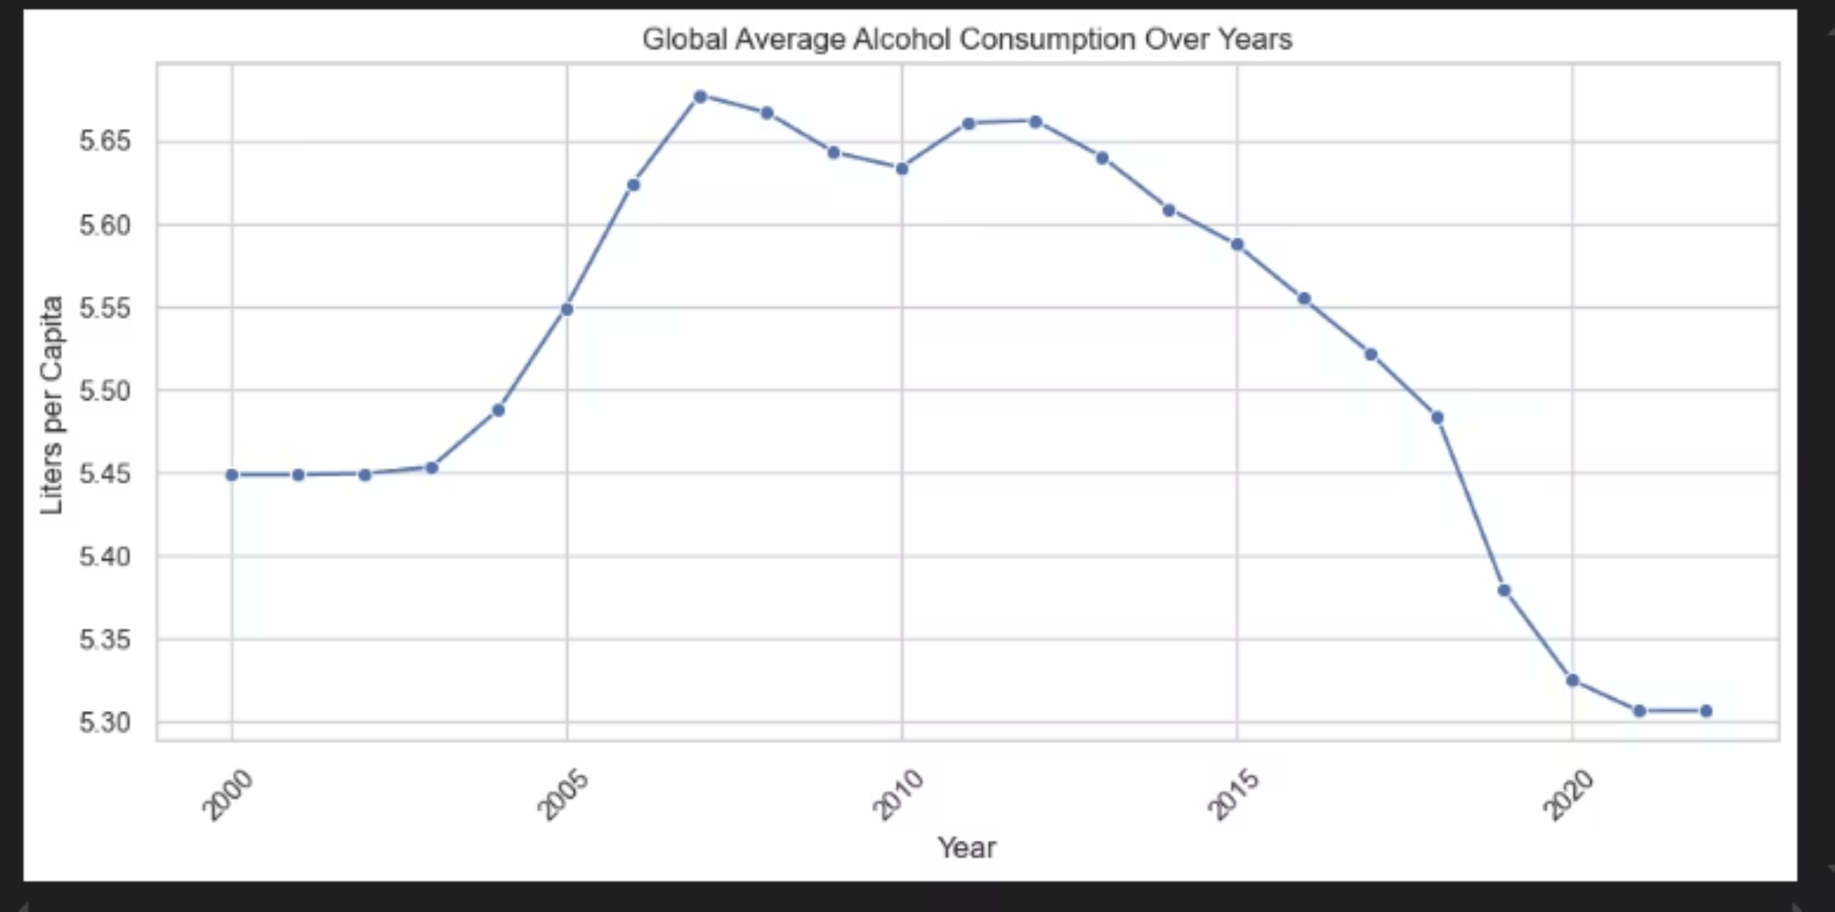
Global Average Alcohol Consumption (2000-2020)
The line plot illustrates global average alcohol consumption (liters per capita) from 2000 to 2020. A peak of approximately 5.65 liters was observed around 2010, followed by a steady decline to roughly 5.35 liters by 2020. This temporal trend provides critical insights for evaluating policy effectiveness.

Slide 7
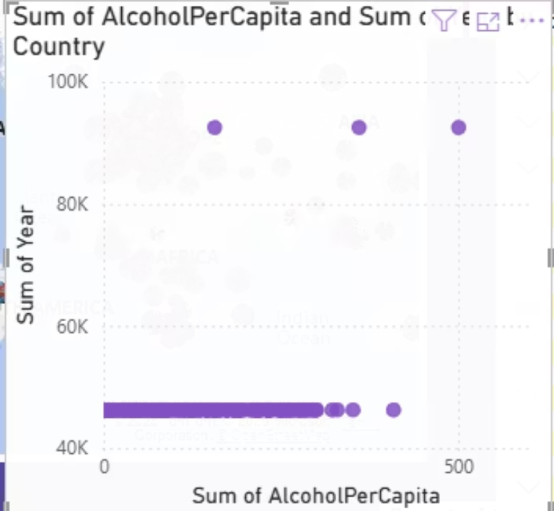
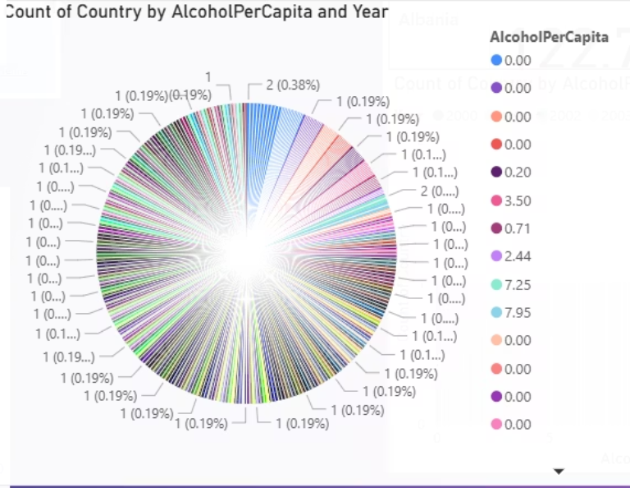
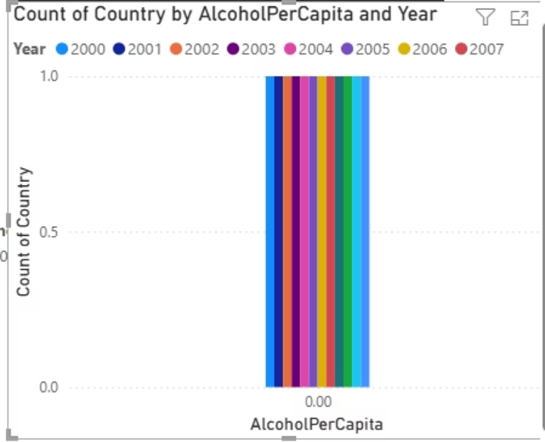
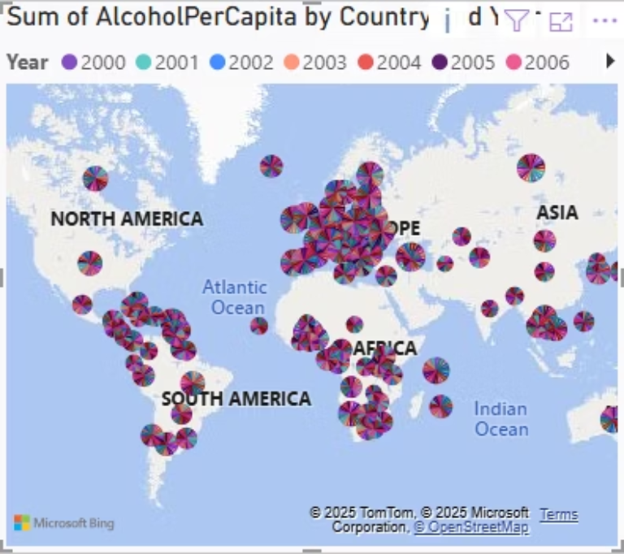
Key Findings: Dissecting Consumption Patterns
Regional Variations
Demographic Insights
Temporal Trend Analysis
Predictive Indicators
Consumption rates vary significantly by region. Countries like Czechia exhibited exceptionally high consumption, reaching 14.56 liters per capita in 2003, highlighting localized challenges.
Males consistently show higher alcohol consumption rates compared to females across most regions, underscoring the need for gender-specific public health campaigns.
Overall global consumption increased up to 2010, then demonstrated a noticeable decline towards 2020, suggesting potential shifts in drinking behaviors or policy impacts.
Year and GDP per capita emerged as the most significant predictors of alcohol consumption, indicating strong correlations between economic development, time, and drinking habits.

Slide 8



Strategic Recommendations for Public Health
Targeted Interventions
Policy Enhancement
Data Harmonization
Implement region-specific interventions and awareness campaigns for high-consumption areas and demographics, focusing on at-risk groups like young males.
Utilize consumption data to inform and strengthen alcohol taxation policies and regulations, aiming to reduce overall consumption and mitigate public health harms.
Advocate for enhanced global data collection standards and consistency to improve the accuracy and comparability of future analyses and policy evaluations.

Slide 9
Future Work: Expanding the Horizon
Real-Time Dashboard
Advanced Modeling
Develop a dynamic, real-time web-based dashboard for continuous monitoring of alcohol consumption trends, providing immediate insights for policy adjustments.
Data Expansion
Explore the application of neural networks and other advanced machine learning models to achieve higher prediction accuracy and deeper pattern recognition.
Integrate broader socio-economic and health-related datasets to enrich the analysis and uncover more complex correlations affecting alcohol consumption.

Slide 10

Conclusion
"Come unto me, all ye that labour and are heavy laden, and I will give you rest."
Matthew 11:28
This project successfully delivers robust, actionable insights into global alcohol consumption trends through the meticulous application of data science and compelling visualizations. By combining the power of Python for analysis and Power BI for interactive dashboards, we have achieved a high level of technical excellence. Our findings are designed to inspire innovation and foster more effective public health strategies worldwide, paving the way for a healthier future.

